Slide 1
Wireless Networks
Advance Computer Networks

Slide 2
Wireless Networks Outline
Terminology, WLAN types, IEEE Standards
RFID (Radio Frequency IDentification)
IEEE 802.11a/b/g/n
802.11 AP Management Functions
Association, scanning
802.11 MAC Sub-Layer
DCF
CSMA/CA
MACAW

Slide 3
Wireless Networks Outline
802.11 MAC Sub-Layer (cont.)
RTS/CTS
PCF
Beacons, DIFS, SIFS
Frame Details
PLCP preamble and header
Address fields
Dynamic Rate Adaptation
Frame Fragmentation

Slide 4
Broad View of Wireless Technologies
Cellular (2G to 4G)
WiMax {long range wireless}
WiFi
WSN’s
Near Field Communications
The focus here is on WiFi technologies and MAC layer issues!!

Slide 5
RFID in Brief
RFID uses radio waves to transfer data from an electronic tag (RFID tag or label), attached to an object, through a reader to identify and track the object.
The tag's information is stored electronically.
Some RFID tags can be read from several meters away and beyond the line of sight of the reader.

Slide 6
RFID in Brief
An RFID reader transmits an encoded radio signal to interrogate the tag.
With a small RF transmitter and receiver, the RFID tag receives the message and responds with its identification information.
Many RFID tags have no battery. Instead, the tag uses the radio energy transmitted by the reader as its energy source.

Slide 7
LAN, WLAN and WSN Terminology
802.3::
Ethernet CSMA/CD
802.11a/b/g/n::
WiFi CSMA/CA
802.15.4::
ZigBee 802.11-based
lower data rates, lower power
Bluetooth::
TDMA
- wireless Personal Area Networks (PANs) that provide secure, globally unlicensed short-range radio communication.
Clusters with max of 8: cluster head + 7 nodes
WBAN (Wireless Body Area Networks):: generally 802.15.4 or TDMA medical PANs
WSNs

Slide 8
Elements of a Wireless Network
wireless hosts
laptop, PDA, smart phone
run applications
may be stationary (non-mobile) or mobile
wireless does not always mean mobility
network
infrastructure
K & R

Slide 9
Elements of a Wireless Network
base station (BS)
typically connected to wired network
relay - responsible for sending packets between wired network and wireless host(s) in its “area”
e.g., cell towers, 802.11 access points
network
infrastructure
K & R

Slide 10
Wireless Local Area Networks (WLANs)
The proliferation of laptop computers and other mobile devices (PDAs and cell phones) created an obvious application level demand for wireless local area networking.
Companies jumped in, quickly developing incompatible wireless products in the 1990’s.
Industry decided to entrust standardization to IEEE committee that dealt with wired LANs
– namely, the IEEE 802 committee!!

Slide 11
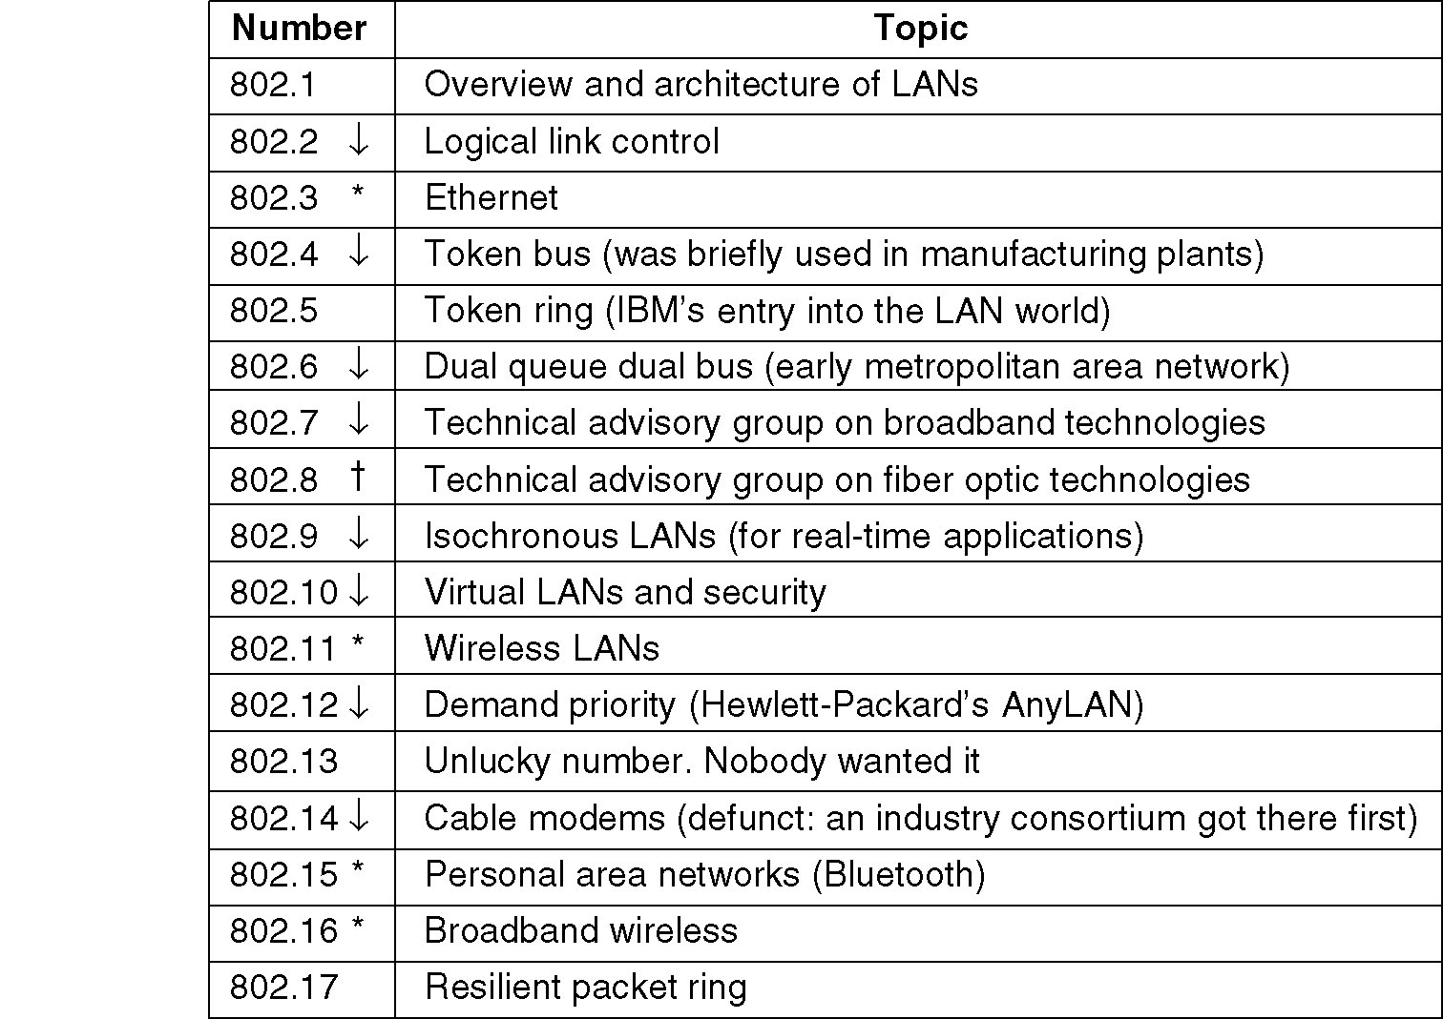
IEEE 802 Standards Working Groups
Tanenbaum
802.15.4 ZigBee
WiMAX
Figure 1-38. The important ones are marked with *. The ones marked with ↓ are hibernating. The one marked with † gave up.

Slide 12
IEEE 802.11
The following IEEE 802.11 standards exist or are in development to support the creation of technologies for wireless local area networking:
802.11a - 54 Mbps standard, 5 GHz signaling (ratified 1999)
802.11b - 11 Mbps standard, 2.4 GHz signaling (1999)
802.11c - operation of bridge connections (moved to 802.1D)
802.11d - worldwide compliance with regulations for use of wireless signal spectrum (2001)
802.11e - Quality of Service (QoS) support (ratified in 2005)
802.11f - Inter-Access Point Protocol recommendation for communication between access points to support roaming clients (2003)
802.11g - 54 Mbps standard, 2.4 GHz signaling (2003)
802.11h - enhanced version of 802.11a to support European regulatory requirements (2003)
802.11i- security improvements for the 802.11 family (2004)
802.11j - enhancements to 5 GHz signaling to support Japan regulatory requirements (2004)
802.11k - WLAN system management (in progress)
About.com

Slide 13
IEEE 802.11
The following IEEE 802.11 standards exist or are in development to support the creation of technologies for wireless local area networking:
802.11m - maintenance of 802.11 family documentation
802.11n - OFDM version at 248 Mbps; MIMO version up to 600 Mbps
** formally voted into the standard in September 2009!
802.11p- Wireless Access for the Vehicular Environment
802.11r - fast roaming support via Basic Service Set transitions
802.11s - ESS mesh networking for access points
802.11t - Wireless Performance Prediction - recommendation for testing standards and metrics
802.11u - internetworking with 3G / cellular and other forms of external networks
802.11v - wireless network management / device configuration
802.11w - Protected Management Frames security enhancement
802.11x- skipped (generic name for the 802.11 family)
802.11y - Contention Based Protocol for interference avoidance
About.com

Slide 14
Wireless Link Standards
200
802.11n
54
802.11a,g
802.11a,g point-to-point
5-11
802.11b
4G: LTWE WIMAX
4
3G: UMTS/WCDMA-HSPDA, CDMA2000-1xEVDO
Data rate (Mbps)
1
802.15
.384
2.5G: UMTS/WCDMA, CDMA2000
.056
2G: IS-95, CDMA, GSM
Indoor
10-30m
Outdoor
50-200m
Mid-range
outdoor
200m – 4 Km
Long-range
outdoor
5Km – 20 Km
K & R

Slide 15
Wireless Link Characteristics
Differences from wired link…
Decreased signal strength: radio signal attenuates as it propagates through matter (path loss).
Interference from other sources: standardized wireless network frequencies (e.g., 2.4 GHz) shared by other devices (e.g., phone); devices (motors) interfere as well.
Multipath propagation: radio signal reflects off objects ground, arriving at destination at slightly different times. {known as multipath fading}
…. makes communication across (even a point to point) wireless link much more difficult.
K & R

Slide 16
Classification of Wireless Networks
Base Station:: all communication via an Access Point (AP) {hub topology}.
Other nodes can be fixed or mobile.
Infrastructure Wireless:: AP is connected to the wired Internet.

Slide 17
Classification of Wireless Networks
Ad Hoc Wireless:: wireless nodes communicate directly with one another.
Mesh Networks:: have a relatively stable topology and usually involve multi-hop routing.
MANETs (Mobile Ad Hoc Networks) :: ad hoc nodes are mobile.
VANETs (Vehicular Ad-Hoc Networks)
a technology that uses moving cars as nodes in a network to create a mobile network.

Slide 18
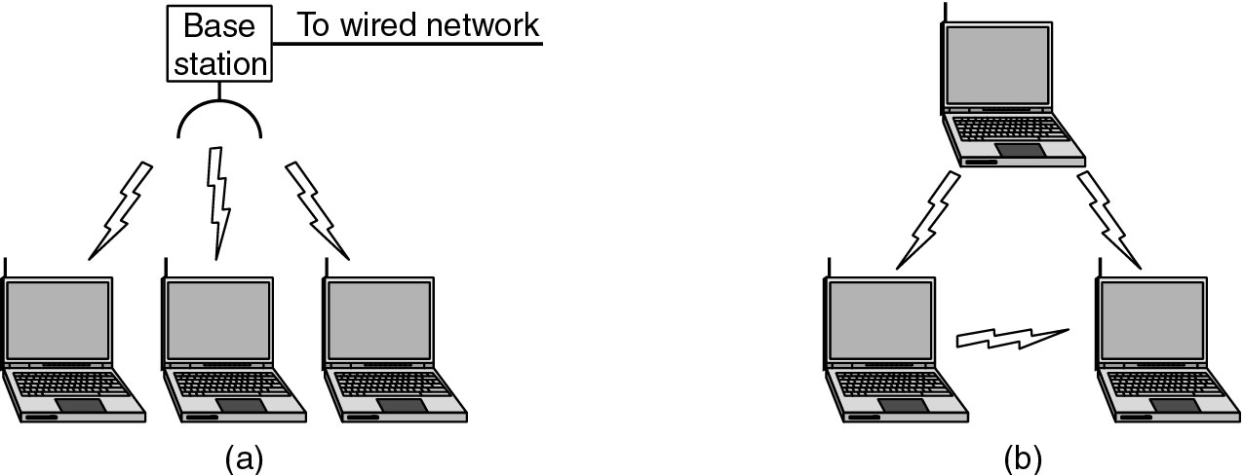
Wireless LANs
Figure 1-36.(a) Wireless networking with a base station. (b) Ad hoc networking.
Tanenbaum

Slide 19
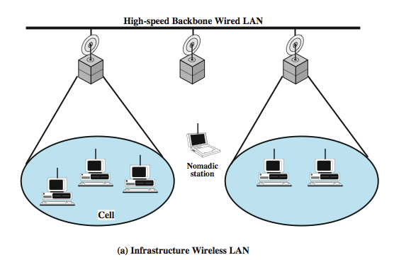
Infrastructure Wireless LAN
DCC 9th Ed.
Stallings
Notes:
Stallings DCC9e Figure 17.3 suggests the differences between a wireless LAN that supports LAN extension and nomadic access requirements and an ad hoc wireless LAN. In the former case, the wireless LAN forms a stationary infrastructure consisting of one or more cells with a control module for each cell. Within a cell, there may be a number of stationary end systems. Nomadic stations can move from one cell to another. In contrast, there is no infrastructure for an ad hoc network. Rather, a peer collection of stations within range of each other may dynamically configure themselves into a temporary network.

Slide 20
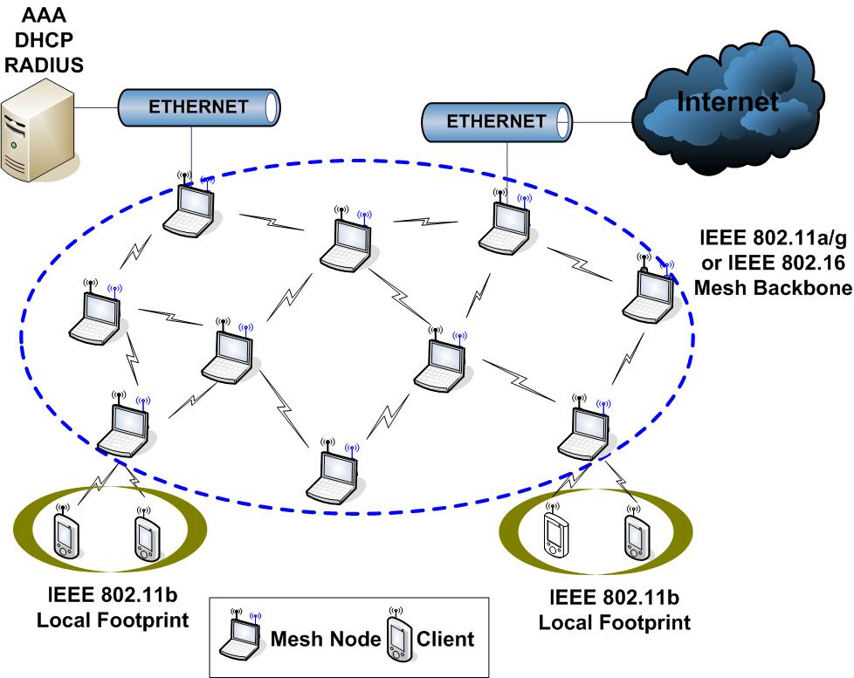
Wireless Mesh Network

Slide 21
Wireless Network Taxonomy
single hop
multiple hops
host connects to
base station (WiFi,
WiMAX, cellular)
which connects to
larger Internet
host may have to
relay through several
wireless nodes to
connect to larger
Internet: Mesh Net
infrastructure
(e.g., APs)
no
infrastructure
no base station, no
connection to larger
Internet (Bluetooth,
ad hoc nets)
no base station, no
connection to larger
Internet. May have to
relay to reach other
wireless nodes.
MANET, VANET
K & R

Slide 22
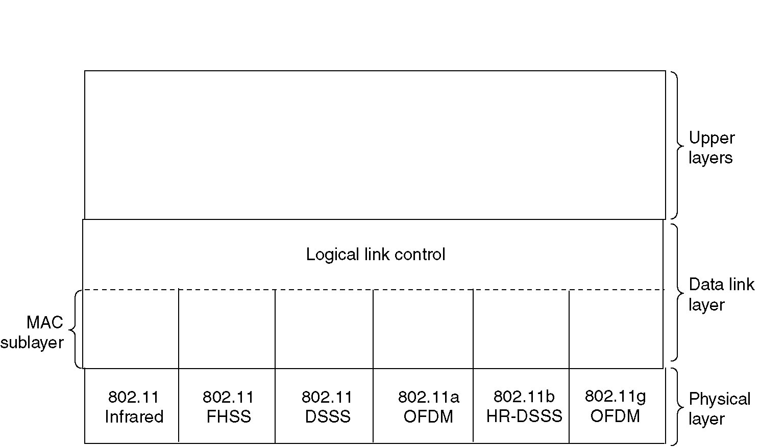
The 802.11 Protocol Stack
802.11n
OFDM SDM
Figure 4-25. Part of the 802.11 protocol stack.
Note – ordinary 802.11 products are no longer being manufactured.
Tanenbaum

Slide 23
IEEE 802.11 Physical Layer
Physical layer conforms to OSI (five options)
1997: 802.11 infrared, FHSS, DSSS {FHSS and DSSS run in the 2.4GHz band}
1999: 802.11a OFDM and 802.11b HR-DSSS
2003: 802.11g OFDM
2009: 802.11n OFDM and MIMO
802.11 Infrared
Two capacities: 1 Mbps or 2 Mbps.
Range is 10 to 20 meters and cannot penetrate walls.
Does not work outdoors.
802.11 FHSS (Frequence Hopping Spread Spectrum)
The main issue is multipath fading.
[P&D] The idea behind spread spectrum is to spread the signal over a wider frequency to minimize the interference from other devices.
79 non-overlapping channels, each 1 Mhz wide at low end of 2.4 GHz ISM band.
The same pseudo-random number generator used by all stations to start the hopping process.
Dwell time: min. time on channel before hopping (400msec).

Slide 24
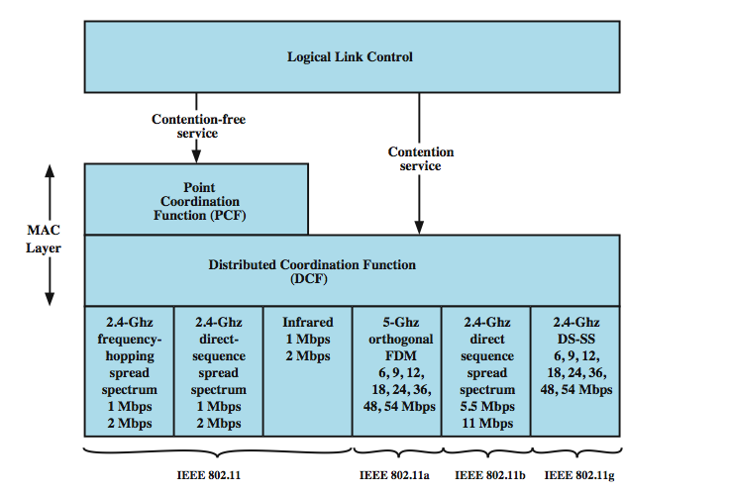
Media Access Control
DCC 9th Ed.
Stallings
Notes:
The 802.11 working group considered two types of proposals for a MAC algorithm: distributed access protocols, which, like Ethernet, distribute the decision to transmit over all the nodes using a carrier sense mechanism; and centralized access protocols, which involve regulation of transmission by a centralized decision maker. A distributed access protocol makes sense for an ad hoc network of peer workstations (typically an IBSS) and may also be attractive in other wireless LAN configurations that consist primarily of bursty traffic. A centralized access protocol is natural for configurations in which a number of wireless stations are interconnected with each other and some sort of base station that attaches to a backbone wired LAN; it is especially useful if some of the data is time sensitive or high priority.
The end result for 802.11 is a MAC algorithm called DFWMAC (distributed foundation wireless MAC) that provides a distributed access control mechanism with an optional centralized control built on top of that. Stallings DCC9e Figure 17.5 illustrates the architecture. The lower sublayer of the MAC layer is the distributed coordination function (DCF). DCF uses a contention algorithm to provide access to all traffic. Ordinary asynchronous traffic directly uses DCF. The point coordination function (PCF) is a centralized MAC algorithm used to provide contention-free service. PCF is built on top of DCF and exploits features of DCF to assure access for its users.

Slide 25
IEEE 802.11 Physical Layer
802.11 DSSS (Direct Sequence Spread Spectrum)
The main idea is to represent each bit in the frame by multiple bits in the transmitted signal (i.e., it sends the XOR of that bit and n random bits).
Spreads signal over entire spectrum using pseudo-random sequence (similar to CDMA see Kurose & Ross Chap 6).
Each bit transmitted using an 11-bit chipping Barker sequence, PSK at 1Mbaud.
This yields a capacity of 1 or 2 Mbps.
unique code
per sender
Figure 2.37 Example 4-bit chipping sequence
P&D slide

Slide 26
Code Division Multiple Access (CDMA)
Used in several wireless broadcast channels (cellular and satellite) standards.
A unique “code” is assigned to each user; i.e., code set partitioning.
All users share the same frequency, but each user has its own chipping sequence (i.e., unique code) to encode data.
encoded signal = (original data) X (chipping sequence)
decoding: inner-product of encoded signal and chipping sequence
Allows multiple users to “coexist” and transmit simultaneously with minimal interference (if codes are “orthogonal”).

Slide 27
CDMA Encode/Decode
Bit width
channel output Z_{i,m}
Z_{i,m}= d_{i}.c_{m}
data
bits
d₀ = 1
1
1
1
1
1
d₁ = -1
1
1
1
-
-
-
-
1
-
-
-
1
-
1
1
1
1
1
sender
1
1
slot 1
channel
output
slot 0
channel
output
1
1
1
1
1
code
1
1
-
-
-
1
-
1
1
1
-
-
-
1
-
1
1
1
slot 1
slot 0
M
D_{i} = Σ Z_{i,m}.c_{m}
m=1
M
received
input
1
1
1
1
1
1
1
1
d₀ = 1
-
-
-
-
1
-
-
-
1
-
1
1
1
1
1
1
d₁ = -1
1
slot 1
channel
output
slot 0
channel
output
1
1
1
1
1
code
1
1
-
-
-
1
-
1
1
1
-
-
-
1
-
1
1
1
receiver
slot 1
slot 0
K & R

Slide 28
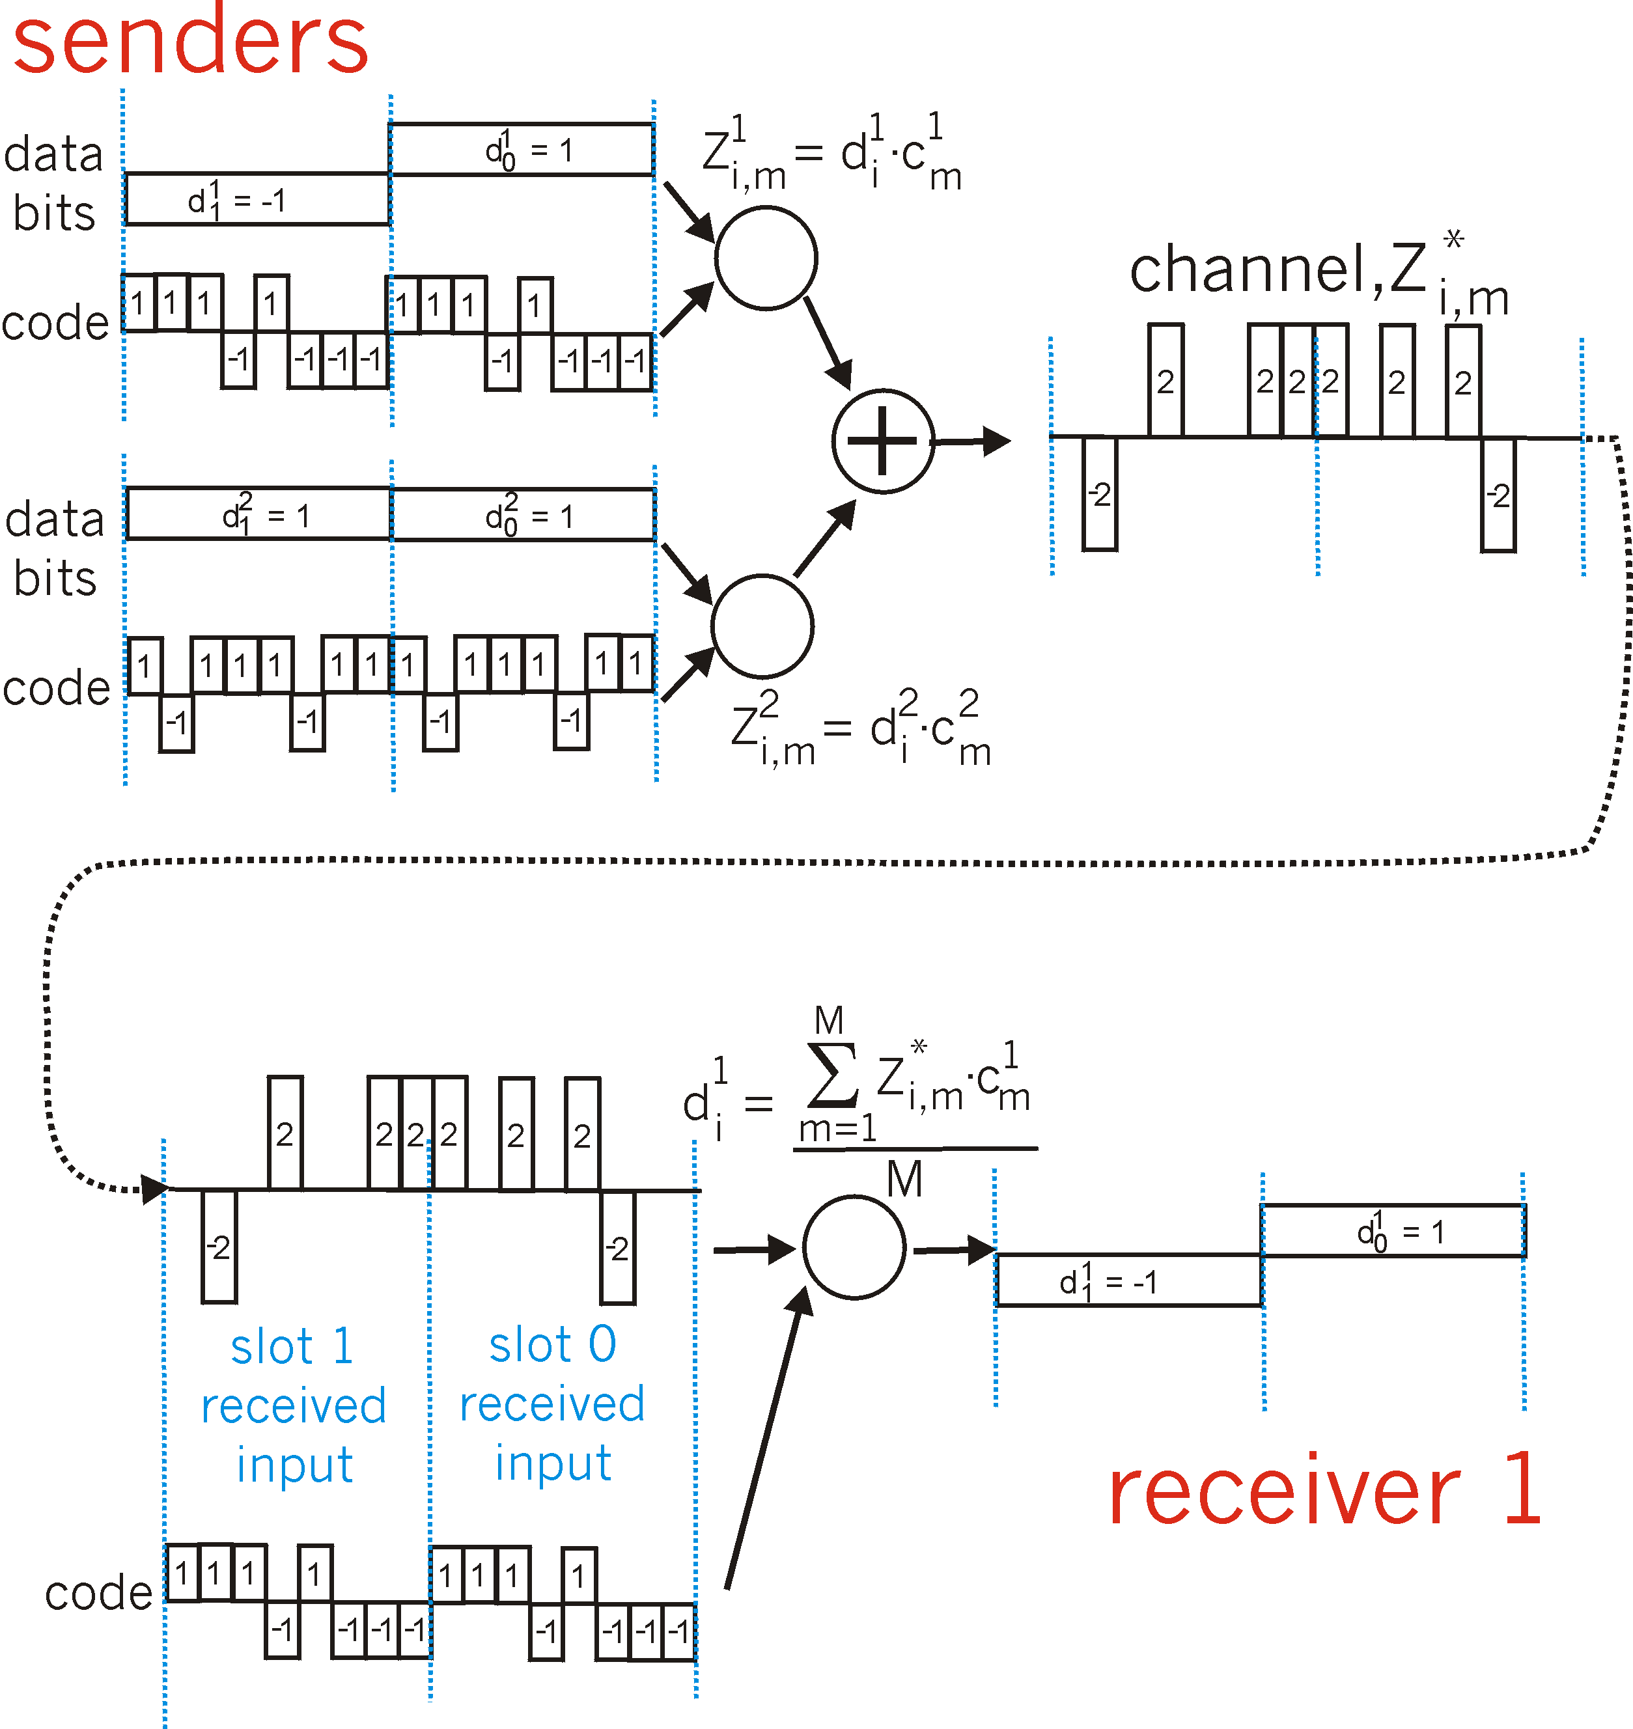
CDMA: Two-Sender Interference
K & R

Slide 29
IEEE 802.11 Physical Layer
802.11a OFDM (Orthogonal Frequency Divisional Multiplexing)
Compatible with European HiperLan2.
54 Mbps in wider 5.5 GHz band ➔ transmission range is limited.
Uses 52 FDM sub-channels (48 for data; 4 for synchronization).
Encoding is complex ( PSM up to 18 Mbps and QAM above this capacity).
E.g., at 54 Mbps 216 data bits encoded into into 288-bit symbols.
More difficulty penetrating walls.
** net achievable throughput in the mid-20Mbps!!

Slide 30
IEEE 802.11 Physical Layer
802.11b HR-DSSS (High Rate Direct Sequence Spread Spectrum)
11a and 11b shows a split in the standards committee.
11b approved and hit the market before 11a.
Up to 11 Mbps in 2.4 GHz band using 11 million chips/sec.
Note in this bandwidth, this protocol has to deal with interference from microwave ovens, cordless phones and garage door openers.
Range is 7 times greater than 11a.
11b and 11a are incompatible!!
** net achievable throughput in low 6Mbps range!!

Slide 31
IEEE 802.11 Physical Layer
802.11g OFDM (Orthogonal Frequency Division Multiplexing)
Tries to combine the best of both 802.11a and 802.11b.
Supports bandwidths up to 54 Mbps.
Uses 2.4 GHz frequency for greater range.
Is backward compatible with 802.11b.
Note – common for products to support 802.11a/b/g in a single NIC.

Slide 32
Data Rate vs Distance (m)
DCC 9th Ed.
Stallings
Notes:
The IEEE 802.11 standards do not include a specification of speed versus distance objectives. Different vendors will give different values, depending on environment. Stallings DCC9e Table 17.5, based on [LAYL04] gives estimated values for a typical office environment.

Slide 33
IEEE 802.11 Physical Layer
802.11n OFDM version at 248 Mbps
Physical Layer Changes:
Multiple-Input-Multiple-Output (MIMO)
maximum of 600 Mbps with the use of four spatial streams at a channel width of 40 MHz.
Spatial Division Multiplexing (SDM)
MAC Layer Changes:
Frame aggregation into single block for transmission.

Slide 34
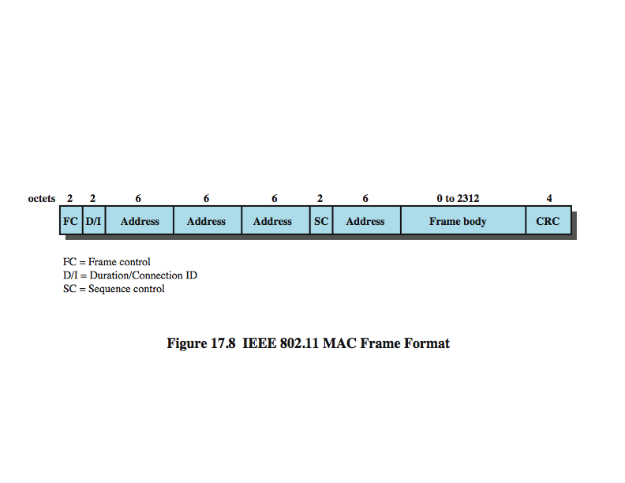
IEEE 802.11 MAC Frame Format
Larger than Ethernet frame
DCC 9th Ed.
Stallings
34
Notes:
Stallings DCC9e Figure 17.8 shows the 802.11 frame format. This general format is used for all data and control frames, but not all fields are used in all contexts. The fields are:
Frame Control: Indicates the type of frame (control, management, or data) and provides control information. Control information includes whether the frame is to or from a DS, fragmentation information, and privacy information.
Duration/Connection ID: If used as a duration field, indicates the time (in microseconds) the channel will be allocated for successful transmission of a MAC frame. In some control frames, this field contains an association, or connection, identifier.
Addresses: The number and meaning of the 48-bit address fields depend on context. The transmitter address and receiver address are the MAC addresses of stations joined to the BSS that are transmitting and receiving frames over the wireless LAN. The service set ID (SSID) identifies the wireless LAN over which a frame is transmitted. For an IBSS, the SSID is a random number generated at the time the network is formed. For a wireless LAN that is part of a larger configuration the SSID identifies the BSS over which the frame is transmitted; specifically, the SSID is the MAC-level address of the AP for this BSS (Stallings DCC9e Figure 17.4). Finally the source address and destination address are the MAC addresses of stations, wireless or otherwise, that are the ultimate source and destination of this frame. The source address may be identical to the transmitter address and the destination address may be identical to the receiver address.
Sequence Control: Contains a 4-bit fragment number subfield, used for fragmentation and reassembly, and a 12-bit sequence number used to number frames sent between a given transmitter and receiver.
Frame Body: Contains an MSDU or a fragment of an MSDU. The MSDU is a LLC protocol data unit or MAC control information.
Frame Check Sequence: A 32-bit cyclic redundancy check.

Slide 35
802.11 LAN Architecture
Internet
wireless host communicates with base station
base station = access point (AP)
Basic Service Set (BSS) (aka “cell”) in infrastructure mode contains:
wireless hosts
access point (AP): base station
ad hoc mode: hosts only
hub, switch
or router
AP
BSS 1
AP
BSS 2
K & R

Slide 36
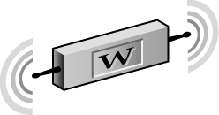

802.11 Management Functions
Channel Selection
Scanning
Station (user) Authentication and Association
Beacon Management
Power Management Mode
Probe
Sent
Beacon
Beacon
Returned
Adv-Nets
Keating

Slide 37
Channels and AP Association
802.11b: 2.4GHz-2.485GHz spectrum divided into 11 channels (overlapping frequencies).
AP admin chooses frequency for AP.
Interference is possible: The channel can be same as that chosen by a neighbor AP!
Wireless nodes must associate with an AP.
Node scans channels, listening for beacon frames containing AP’s name (SSID) and MAC address.
Node makes choice for AP association {default is best RSSI}.
may perform authentication [K&R Chapter 8].
will typically run DHCP to get IP address in AP’s subnet.

Slide 38
802.11 Overlapping Channels
802.11b/g transmission occurs on one of 11 overlapping channels in the 2.4GHz North American ISM band.
Adv-Nets
Keating
2.417
2.427
2.437
2.447
2.457
2.467
5
10
4
9
14
3
8
13
2
7
12
1
6
11
2.412
2.422
2.432
2.442
2.452
2.462
2.472
2.484

Slide 39
802.11: Passive/Active Scanning
BBS 1
BBS 2
BBS 1
BBS 2
AP 1
AP 2
AP 1
1
AP 2
1
1
2
2
2
3
3
4
H1
H1
Passive Scanning
beacon frames sent from APs.
association Request frame sent: H1 to selected AP.
association Response frame sent: AP to H1.
Active Scanning
Probe Request frame broadcast from H1.
Probe Response frame sent from APs.
Association Request frame sent: H1 to selected AP.
Association Response frame sent: AP to H1.
K & R

Slide 40
802.11 MAC Layer Protocol
In 802.11 wireless LANs, “seizing the channel” does not exist as in 802.3 wired Ethernet.
Two additional problems:
Hidden Terminal Problem
Exposed Station Problem
To deal with these two problems 802.11 supports two modes of operation:
DCF (Distributed Coordination Function)
PCF (Point Coordination Function).
All implementations must support DCF, but PCF is optional.

Slide 41
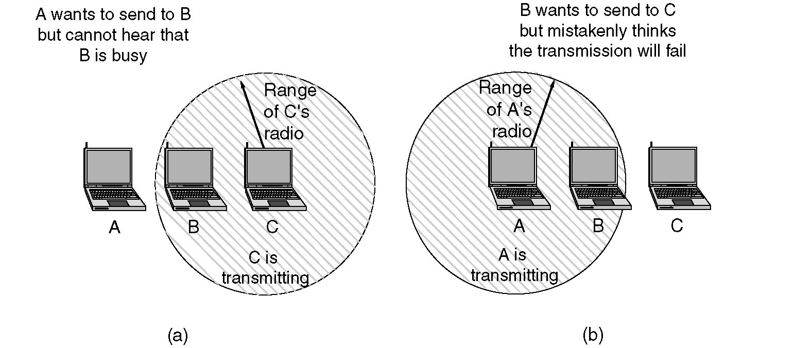
Figure 4-26.(a)The hidden terminal problem. (b) The exposed station problem.
802.11 Problems
Tanenbaum

Slide 42
The Hidden Terminal Problem
Wireless stations have transmission ranges and not all stations are within radio range of each other.
Simple CSMA will not work!
C transmits to B.
If A “senses” the channel, it will not hear C’s transmission and falsely conclude that A can begin a transmission to B.

Slide 43
The Exposed Station Problem
This is the inverse problem.
B wants to send to C and listens to the channel.
When B hears A’s transmission, B falsely assumes that it cannot send to C.

Slide 44
Distribute Coordination Function (DCF)
CSMA/CA (CSMA with Collision Avoidance) uses one of two modes of operation:
virtual carrier sensing
physical carrier sensing
The two methods are supported by:
1. MACAW (Multiple Access with Collision Avoidance for Wireless) with virtual carrier sensing.
2. 1-persistent physical carrier sensing.

Slide 45
Wireless LAN Protocols [Tanen pp.279-280]
MACA protocol reduces hidden and exposed terminal problems:
Sender broadcasts a Request-to-Send (RTS) and the intended receiver sends a Clear-to-Send (CTS).
Upon receipt of a CTS, the sender begins transmission of the frame.
RTS,CTS helps determine who else is in range or busy (Collision Avoidance).
- Can a collision still occur?

Slide 46
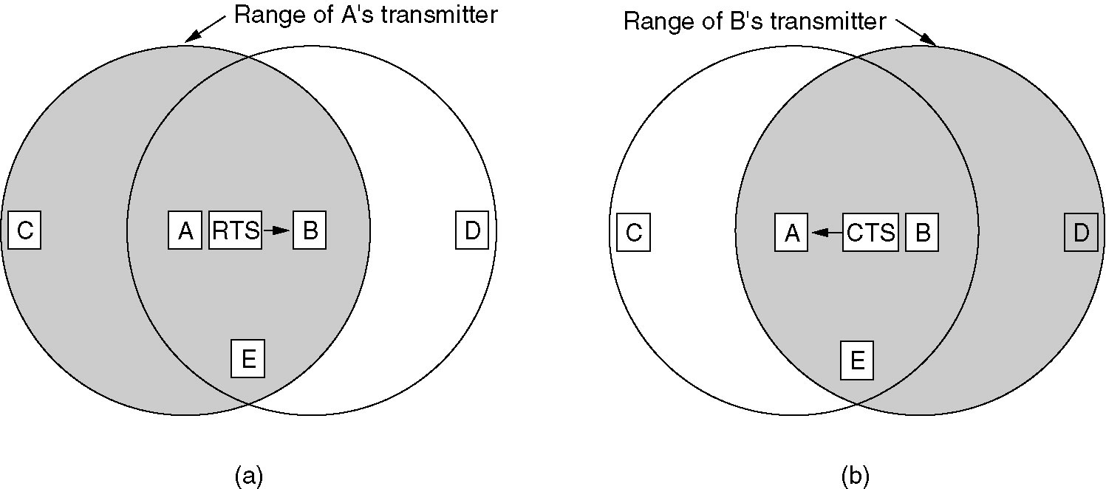
Wireless LAN Protocols
MACAW added ACKs, Carrier Sense, and BEB done per stream and not per station.
Figure 4-12. (a) A sending an RTS to B.
(b) B responding with a CTS to A.
Tanenbaum

Slide 47
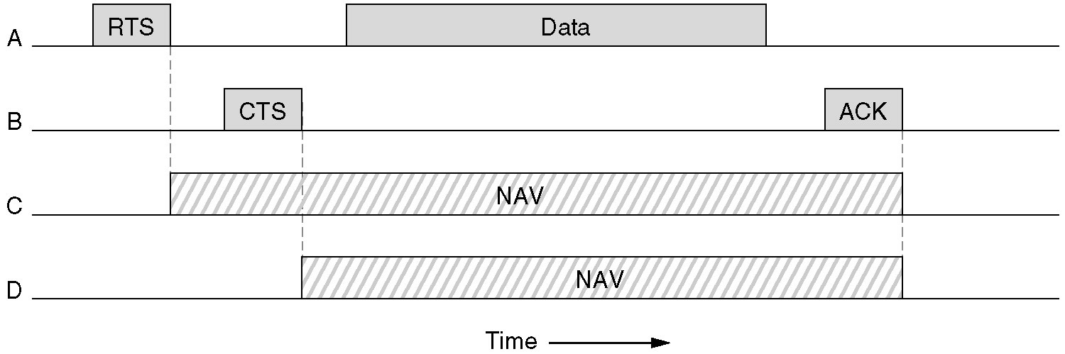
Virtual Channel Sensing in CSMA/CA
Figure 4-27. The use of virtual channel sensing using CSMA/CA.
C (in range of A) receives the RTS and based on information in RTS creates a virtual channel busy NAV (Network Allocation Vector).
D (in range of B) receives the CTS and creates a shorter NAV.
Tanenbaum

Slide 48
Collision Avoidance: RTS-CTS Exchange
K & R
A
B
AP
RTS(B)
RTS(A)
reservation collision
RTS(A)
CTS(A)
CTS(A)
DATA (A)
NAV
defer
time
ACK(A)
ACK(A)

Slide 49
Virtual Channel Sensing in CSMA/CA
What is the advantage of RTS/CTS?
RTS is 20 bytes, and CTS is 14 bytes.
MPDU can be 2300 bytes.
“virtual” implies source station sets the duration field in data frame or in RTS and CTS frames.
Stations then adjust their NAV accordingly!

Slide 50
1-Persistent Physical Carrier Sensing
The station senses the channel when it wants to send.
If idle, the station transmits.
A station does not sense the channel while transmitting.
If the channel is busy, the station defers until idle and then transmits (1-persistent).
Upon collision (no ACK received), wait a random time using binary exponential backoff (BEB).

Slide 51
IEEE 802.11 MAC Protocol: CSMA/CA
802.11 sender
1 if sense channel idle for DIFS then
Transmit entire frame (no CD).
2 if sense channel busy then
Choose a random backoff time.
When channel is busy, counter is frozen.
Timer counts down while channel idle and
transmit when timer expires.
if no ACK, increase random backoff interval, repeat 2.
802.11 receiver
- if frame received OK
return ACK after SIFS (ACK needed due to hidden terminal problem.)
sender
receiver
DIFS
data
SIFS
ACK
K & R

Slide 52
Point Coordinated Function (PCF)
PCF uses a base station (BS) to poll other stations to see if they have frames to send.
No collisions occur.
Base station sends beacon frame periodically.
Base station can tell another station to sleep to save on batteries and base station holds frames for sleeping station.
Subsequently, BS awakens sleeping node via beacon frame.

Slide 53
DCF and PCF Co-Existence
Distributed and centralized control can co-exist using InterFrame Spacing.
SIFS (Short IFS):: the time waited between packets in an ongoing dialog (RTS,CTS,data, ACK, next frame)
PIFS (PCF IFS):: when no SIFS response, base station can issue beacon or poll.
DIFS (DCF IFS):: when no PIFS, any station can attempt to acquire the channel.
EIFS (Extended IFS):: lowest priority interval used to report bad or unknown frame.

Slide 54
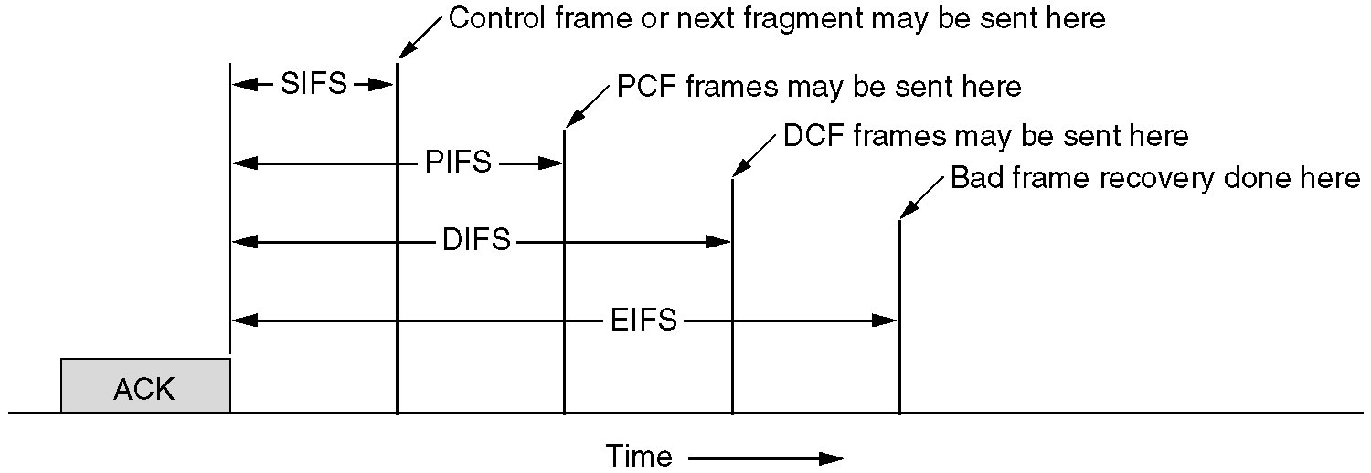
Inter-frame Spacing in 802.11
Figure 4-29. Interframe Spacing in 802.11.
Tanenbaum

Slide 55
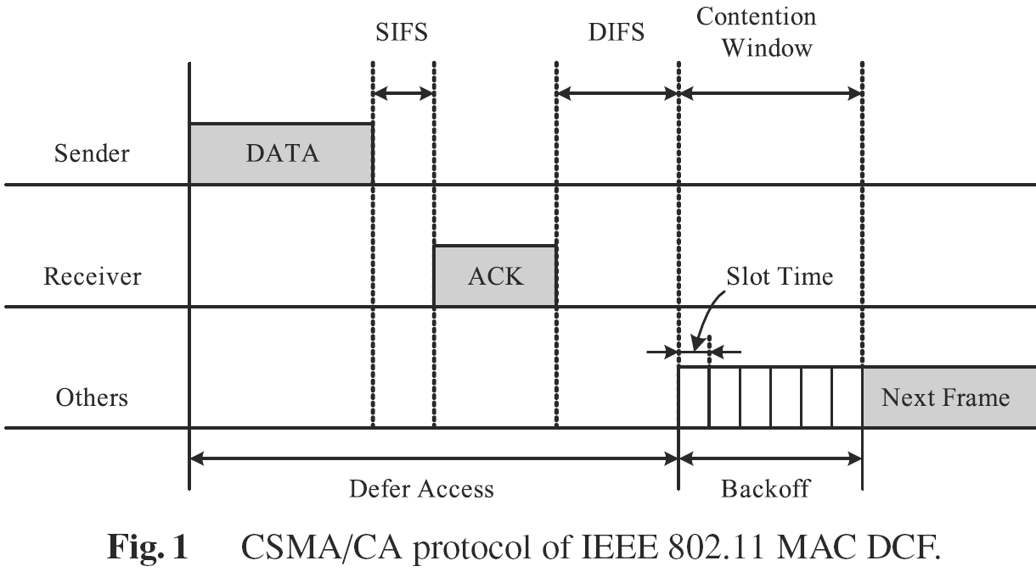
Basic CSMA/CA
possible
collision !!
[N. Kim]

Slide 56
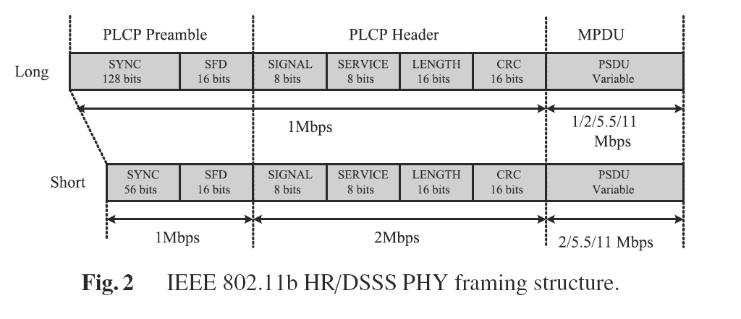
802.11b Physical Layer
‘Adjust transmission rate on the fly’
[N. Kim]

Slide 57
802.11 Frames - Addresses
2
2
6
6
6
2
6
0 - 2312
4
frame
control
duration
address
1
address
2
address
3
seq
control
address
4
payload
CRC
Address 4: used only in ad hoc mode
Address 1: MAC address
of wireless host or AP
to receive this frame
Address 3: MAC address
of router interface to which AP is attached
Address 2: MAC address
of wireless host or AP
transmitting this frame

Slide 58
802.11 Frame - Addresses
router
Internet
H1
R1
AP
R1 MAC addr H1 MAC addr
dest. address
source address
802.3 frame
AP MAC addr H1 MAC addr R1 MAC addr
address 1
address 2
address 3
802.11 frame
K & R

Slide 59
802.11 Frame Addresses (more)
duration of reserved
transmission time (RTS/CTS)
frame seq # (for RDT)
2
2
6
6
6
2
6
0 - 2312
4
frame
control
duration
address
1
address
2
address
3
seq
control
address
4
payload
CRC
2
2
4
1
1
1
1
1
1
1
1
Protocol
version
Type
Subtype
To
AP
From
AP
More
frag
Retry
Power
mgt
More
data
WEP
Rsvd
frame type
(RTS, CTS, ACK, data)
K & R

Slide 60
802.11: Mobility within Same Subnet
H1 remains in same IP subnet: IP address can remain same.
Switch: Which AP is associated with H1?
Uses self-learning (Ch. 5)
Switch will see frame from H1 and “remember” which switch port can be used to reach H1.
router
hub or
switch
BBS 1
AP 1
AP 2
H1
BBS 2
K & R

Slide 61
Wireless Network Details
All APs (or base stations) will periodically send a beacon frame (10 to 100 times a second).
Beacon frames are also used by DCF to synchronize and handle nodes that want to sleep.
Node sets Power management bit to indicate going to sleep and timer wakes node up for next beacon.
The AP will buffer frames intended for a sleeping wireless client and wakeup for reception with beacon frame.

Slide 62
Wireless Network Details
AP downstream/upstream traffic performance is asymmetric.
AP has buffers for downstream/upstream queueing.
Wireless communication quality between two nodes can be asymmetric due to multipath fading.{Characterization paper shows this!}

Slide 63
Dynamic Rate Adaptation
802.11b, g and n use dynamic rate adaptation based on frame loss (algorithms internal to wireless card at the AP).
e.g. for 802.11b choices are: 11, 5.5, 2 and 1 Mbps
Standard 802.11 retries:
7 retries for RTS and CTS
4 retries for Data and ACK frames
RTS/CTS may be turned off by default. [Research has shown that RTS/CTS degrades performance when hidden terminal is not an issue].

Slide 64
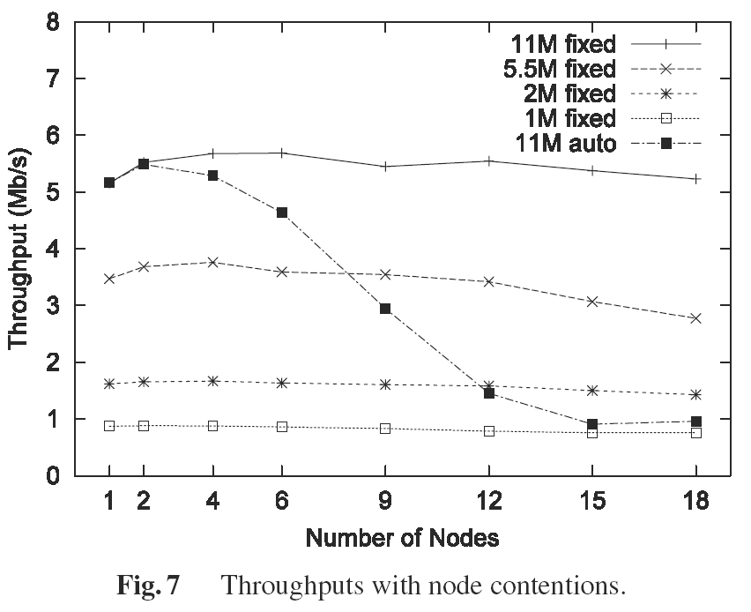
Node Contention
without RTS/CTS
[N. Kim]
64
64

Slide 65
Wireless Link Characteristics
SNR: signal-to-noise ratio
larger SNR – easier to extract signal from noise.
SNR versus BER tradeoffs
given a physical layer: increase power -> increase SNR-> decrease BER.
given a SNR: choose physical layer that meets BER requirement, aiming for highest throughput.
SNR may change with mobility: dynamically adapt physical layer (modulation technique, rate).
10⁻¹
10⁻²
10⁻³
BER
10⁻⁴
10⁻⁵
10⁻⁶
10⁻⁷
10
20
30
40
SNR(dB)
QAM256 (8 Mbps)
QAM16 (4 Mbps)
K & R
BPSK (1 Mbps)

Slide 66
Dynamic Rate Adaptation
Mobile Node Example:
1. SNR decreases, BER increases as node moves away from base station.
2. When BER becomes too high, switch to lower transmission rate but with lower BER.
Idea:: lower maximum data rate for higher throughput.
K & R
10⁻¹
10⁻²
10⁻³
BER
10⁻⁴
10⁻⁵
10⁻⁶
10⁻⁷
10
20
30
40
SNR(dB)
QAM256 (8 Mbps)
QAM16 (4 Mbps)
BPSK (1 Mbps)
operating point
Note - Performance Anomaly paper shows there are other issues when wireless flows contend at AP !

Slide 67
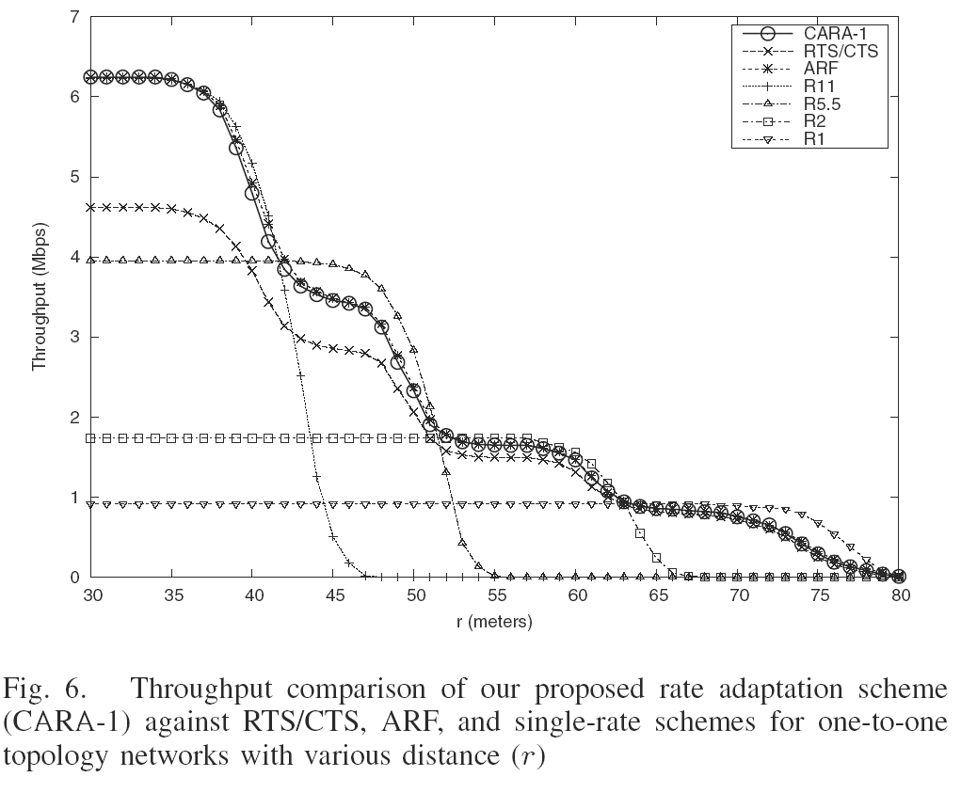
Rate Adaptation versus Distance
[CARA paper]
67
67

Slide 68
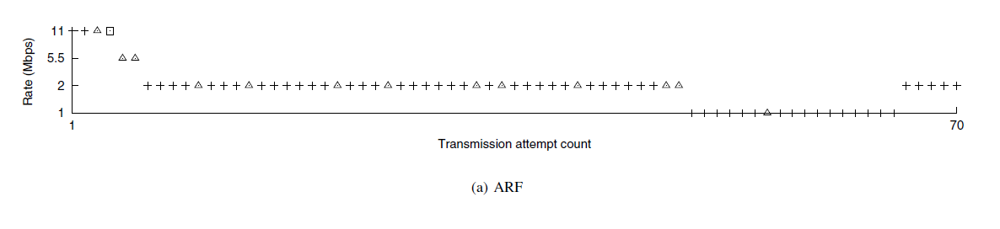
ARF – Original Rate Adaptation
Adapts upward after 10 successes
[CARA paper]

Slide 69
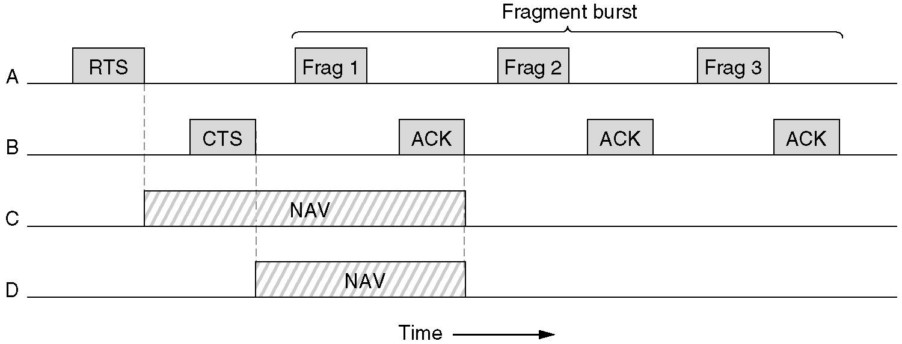
Figure 4-28 Fragmentation in 802.11
High wireless error rates ➔ long packets have less probability of being successfully transmitted.
Solution: MAC layer fragmentation with stop-and-wait protocol on the fragments.
Tanenbaum

Slide 70
Wireless Networks Summary
Terminology, WLAN types, IEEE Standards
Infrastructure, ad hoc, MANET, Base Station, Access Point, single and multi-hop
IEEE 802.11a/b/g/n
Differences in data rate and transmission technologies
FHSS, DSSS, CDMA, OFDM, HR-DSSS, MIMO

Slide 71
Wireless Networks Summary
802.11 AP Management Functions
Association with AP, active and passive scanning, beacon frames
802.11 MAC Sub-Layer
Overlapping channels
Hidden terminal problem, exposed station problem
DCF
CSMA/CA
MACAW

Slide 72
Wireless Networks Summary
802.11 MAC Sub-Layer (cont.)
RTS/CTS
PCF
Beacons, DIFS, SIFS, sleeping nodes
Frame Details
PLCP preamble and header
3 or 4 Address fields used in 802.11
SNR vs BER issues
Dynamic Rate Adaptation
Frame Fragmentation

